Slide 1


Foundations of Biostatistics I
DEPH 312 Principles of Scientific Evidence
Talal Alshihayb ^{BDS, DScD}
Diplomate, American Board of Dental Public Health
Assistant Professor
Department of Preventive Dental Science, College of Dentistry, King Saud bin Abdulaziz University for Health Sciences
Department of Health Policy and Health Services Research, Henry M. Goldman School of Dental Medicine, Boston University
December 21, 2023
shihaybt@ksau-hs.edu.sa

Slide 2
Recap
Study tasks
Measures of disease occurrence
Measures of association
Study designs
Validity and precision
Random and systematic errors in research
Causality and causal effects

Slide 3
Study designs
Descriptive task
Causal task
Case reports
Cohort
(longitudinal)
Observational
Interventional/experimental
Case series
Cross-sectional
Case-crossover
Cross-sectional
Randomized clinical trials
Ecological
Cohort
(longitudinal)
Case-control

Slide 4
Errors in research
1
Random (precision)
Affects measures of dispersion (variance/standard deviation/range)
May affect point estimates (prevalence/incidence/effect size e.g., risk difference)
Systematic (validity)
Affects point estimates (prevalence/incidence/effect size e.g., risk difference)
What do we mean by this?
Difference between true causal effect and associational effect estimated from data
Structural reasons
2

Slide 5
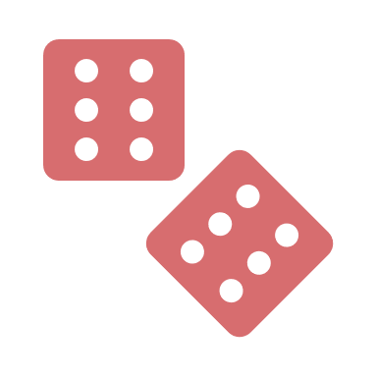








Potential explanations of an association
Systematic errors
1
2
3
4
5
6
Random error
Sharing a common cause
(confounding bias)
Conditioning on a common effect
(selection bias)
Measurement error
(measurement bias)
Reverse causation
Causal

Slide 6

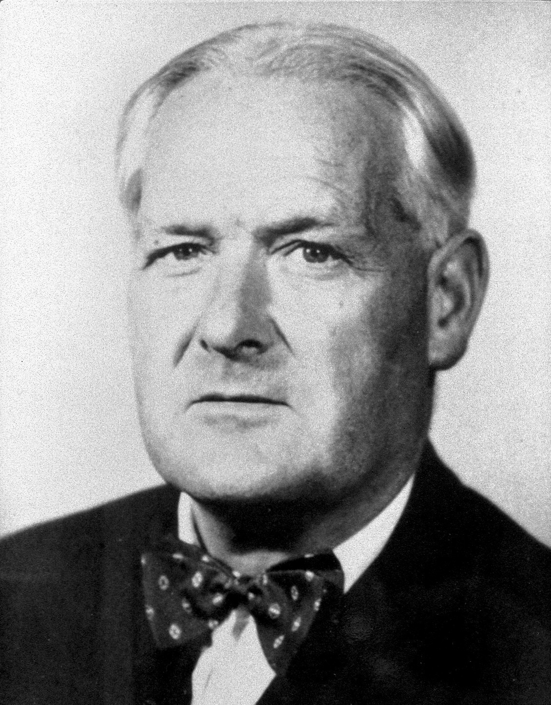
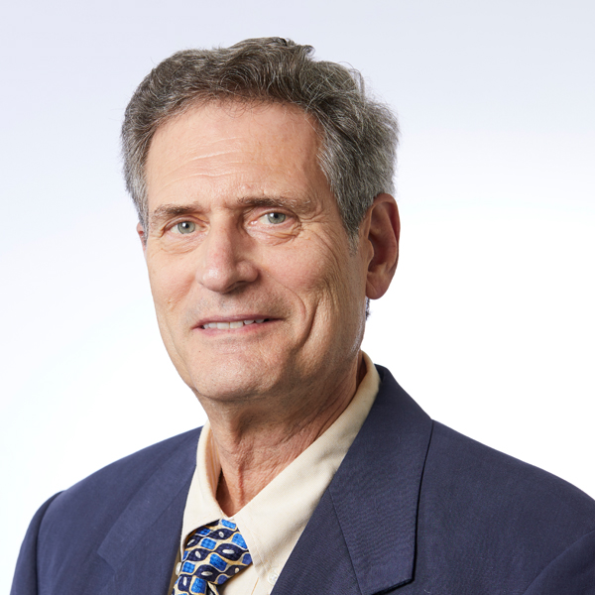
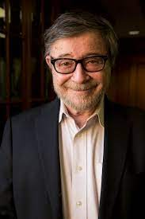
Causality in health research
Bradford Hill
Kenneth Rothman
Judea Pearl
https://upload.wikimedia.org/wikipedia/commons/e/eb/Austin_Bradford_Hill.jpg
https://www.bu.edu/sph/files/2013/10/Kenneth-Rothman-1.jpg
https://www.google.com/url?sa=i&url=http%3A%2F%2Fbayes.cs.ucla.edu%2Fjp_home.html&psig=AOvVaw17zdOKSRPQGJjWLynkbkm7&ust=1670779895085000&source=images&cd=vfe&ved=0CBAQjRxqFwoTCLjfiaPK7_sCFQAAAAAdAAAAABAE
9 criteria for causality
Sufficient component cause (causal pie)
Causal inference

Slide 7
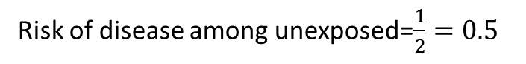
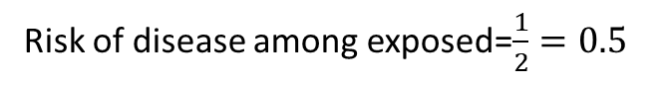
Causal Inference
Average treatment effect (ATE)=average effect if everyone is treated vs. if everyone is not treated
Person | Hypothetical |  | Hypothetical
Person | Will get disease if receiving drug (1=Yes, 0=No) | Will get disease if not receiving drug (1=Yes, 0=No) | Individual effect (1=Causal, 0=no effect, -1=preventive)
Khalid | 1 | 0 | 1
Ahmad | 0 | 0 | 0
Ruba | 0 | 0 | 0
Shaden | 0 | 1 | -1
Total | 1 | 1 | 0
Actual
Received drug (1=Yes, 0=No) | Received no drug (1=Yes, 0=No) | Got disease if receive drug | Got disease if receive no drug
1 | 0 | 1 | ?
0 | 1 | ? | 0
1 | 0 | 0 | ?
0 | 1 | ? | 1
2 | 2 | 1 | 1
Sum of individual effects=1+0+0+(-1)=0
Risk difference=0.5-0.5=0
Assumptions
 | Diseased | Non-diseased | Total
Exposed | 1 | 1 | 2
Unexposed | 1 | 1 | 2
Total | 2 | 2 | 4
Risk of disease among exposed=$\frac{1}{2}=0.5$
Risk of disease among unexposed=$\frac{1}{2}=0.5$

Slide 8
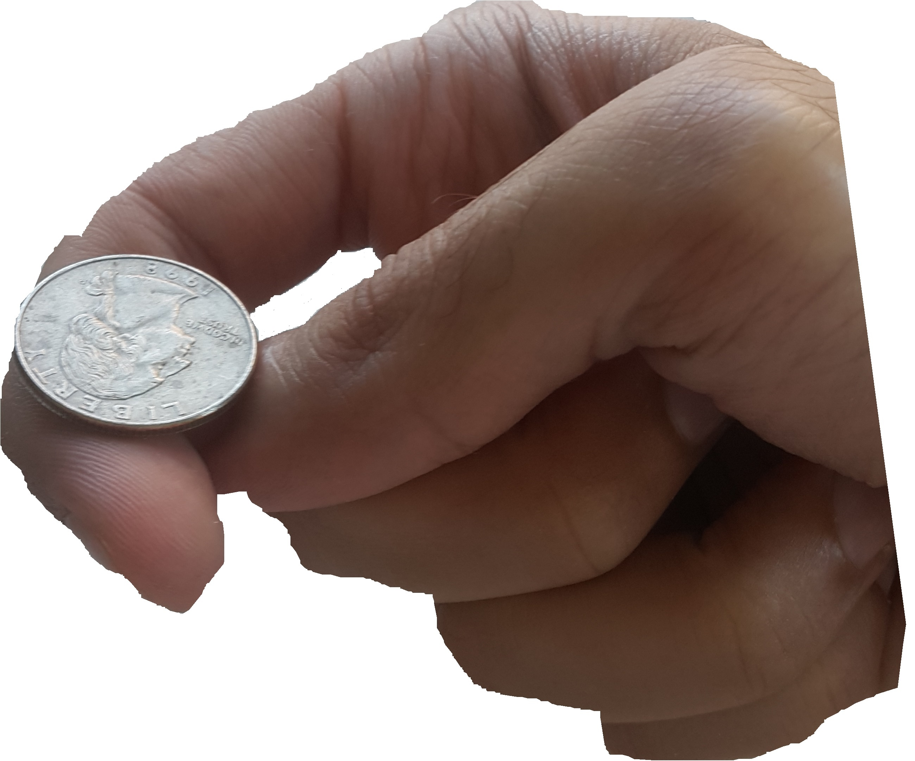

Randomized clinical trials (RCTs)
This means:
100% (everyone) assigned to take the drug actually took the drug
and
0% (no one) assigned to not take drug actually took the drug
(adherence is complete or 100% adherence or compliance)
Risk difference=1
Risk difference=0.2
Causal effect of drug on periodontitis= 0.2
Per-protocol effect
Causal effect of random assignment to drug on periodontitis= 1*0.2 = 0.2
Intention-to-treat effect

Slide 9
LECTURE LEARNING OUTCOMES OF EACH OF THE DIDACTIC SESSIONS
REFERENCE:
Chapter 3 in Aday LA, Cornelius LJ. Designing and conducting health surveys: a comprehensive guide. John Wiley & Sons; 2006 Apr 14
Chapter 3 in The effect: An Introduction to Research Design and Causality by Nick Huntington-Klein https://theeffectbook.net/
LECTURE LEARNING OUTCOMES:
Define a variable
Identify the different types of variables
Describe a variable

Slide 10

What is a variable?

Slide 11



What is a variable?

Slide 12
Type of variables

Slide 13


Types of variables
Qualitative (categorical)
Quantitative (numerical)
Nominal
Ordinal
Interval
Ratio

Slide 14
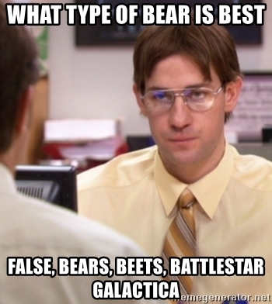
Nominal
No order
No equal distance between categories
Example
Gender
Binary (yes/no)
Colors

Slide 15
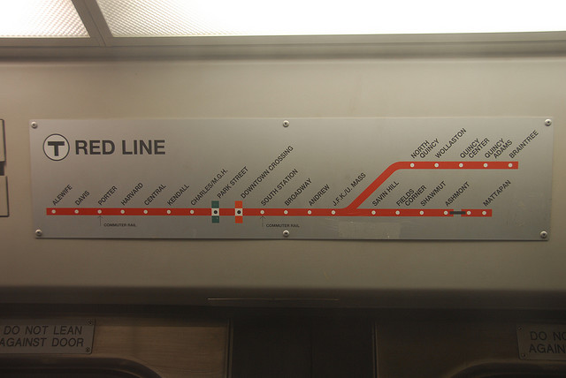
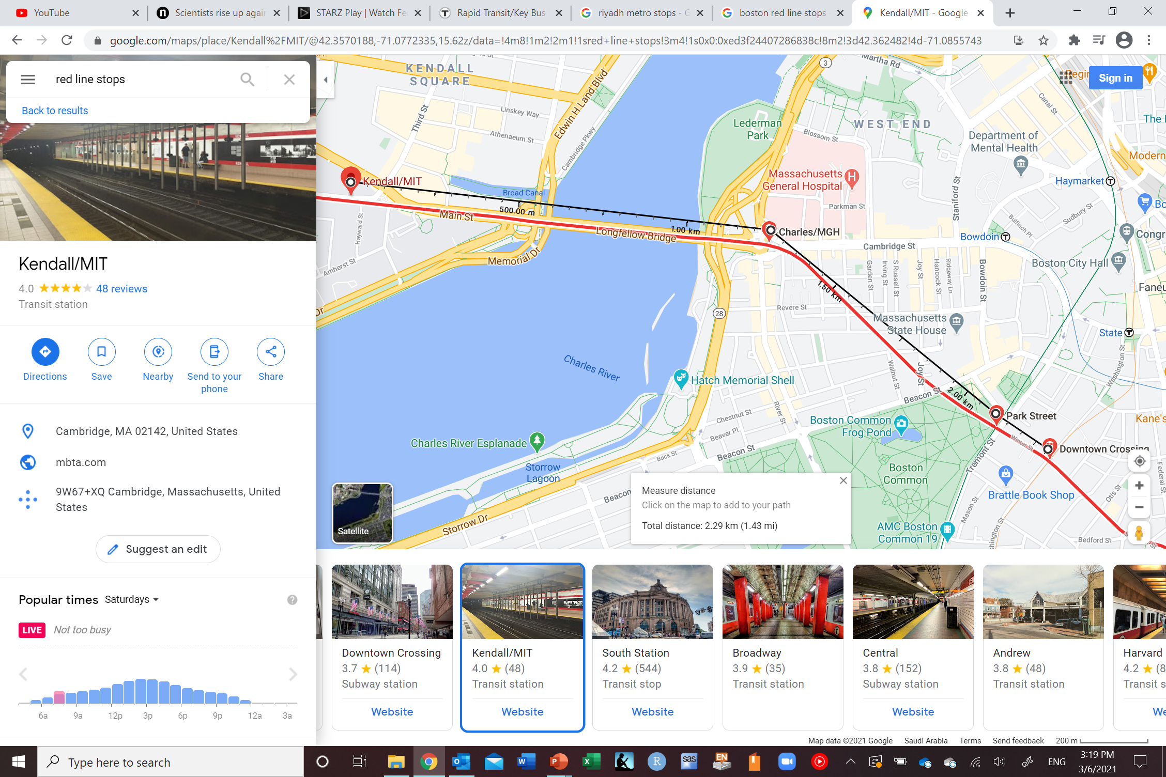
Ordinal
Can be ordered
No equal distance
Example
Likert scale
Very hard
Hard
Neutral
Easy
Very easy

Slide 16
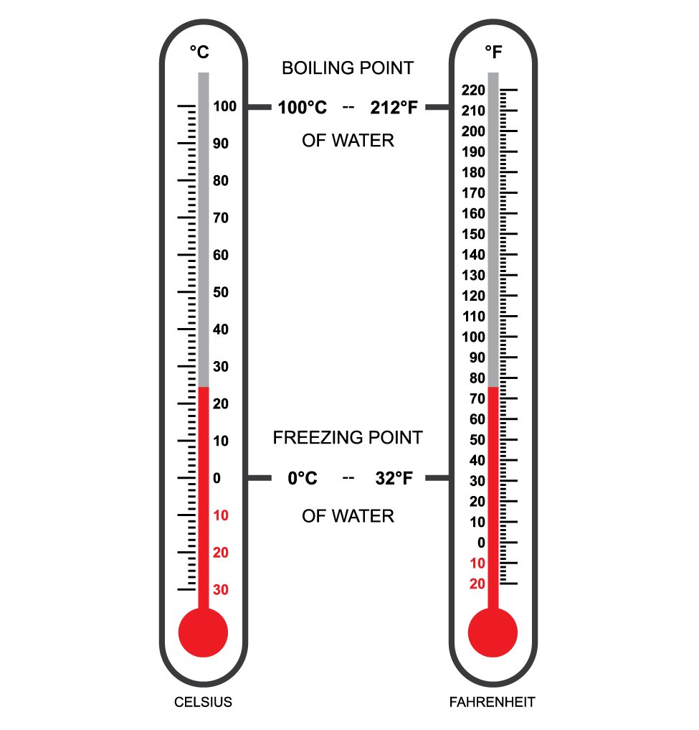
Interval
Can be ordered
Equal distance between categories
No true zero (0 does not imply absence
of variable)
Example
Temperature
IQ

Slide 17



Ratio
Can be ordered
Equal distance between categories
Has true zero (0 means absence of variable)
Examples

Slide 18
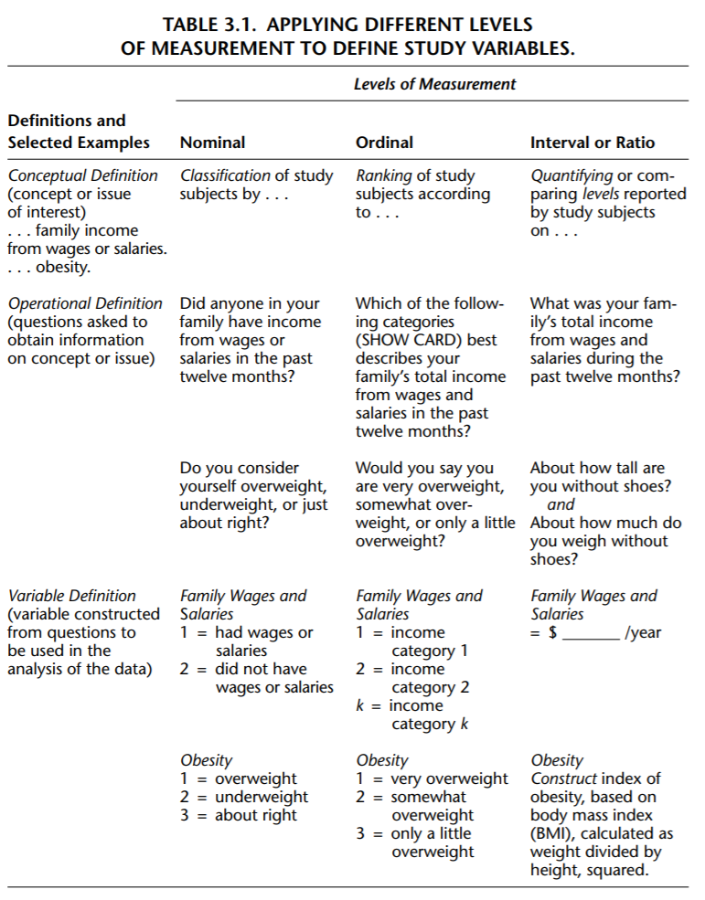

Slide 19


Quantitative (numerical)
Discrete (count)
Continuous
Integers only (no decimals)
Can have decimals

Slide 20
Defining variables
Researchers should have a clear idea of
Precise concept to be captured by asking question
How the question should be asked
How variables should be created from question
Method used to evaluate validity and reliability of question

Slide 22
Translating concepts into operational definition
Dictated by the research question
Concept examples
Smoking
Age
Education
Income
Gender
Alcohol consumption
Dental decay
Periodontitis
Fluorosis
Trauma
Etc.
Operational definitions: actual questions to be asked or procedures to be used to gather information about concepts of interest in a study

Slide 23
Translating concepts into operational definition
Concept: obesity
Operational definition: body mass index using height and weight
Need to collect data on height and weight by asking questions
Formulate question about height and weight

Slide 25
Variables in studies
Exposure variable (independent variable)
You want to study its effect on the outcome
Outcome variable (dependent variable)
The variable you want to assess with respect to the exposure
Covariates (any other variable besides the exposure or the outcome)

Slide 26
Examples

Slide 27
What type of variable is the following?
Smoking as yes or no

Slide 28
What type of variable is the following?
Number of accidents someone had in the previous year

Slide 29
What type of variable is the following?
Gender as male or female

Slide 30
What type of variable is the following?
Difficulty of the course so far as not difficult, neutral, or difficult

Slide 31
What type of variable is the following?
The ages of your batch in years and months

Slide 32
What type of variable is the following?
The ages of your batch in age groups

Slide 33
What type of variable is the following?
Body mass index as underweight, normal, or obese

Slide 34
What type of variable is the following?
Body mass index as any value

Slide 35
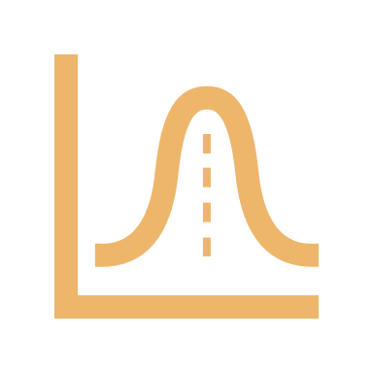
Distribution
We are interested in how the observations are distributed
But what is a distribution?
How frequently the different values occur

Slide 36
Distribution
?
?
?
?

Slide 37
Distribution
First step is to know the type of variable

Slide 38
Describing categorical variables
Let’s say I want to know the distribution of having diabetes among your batch. How can we describe this variables?
Diabetic
Non-diabetic
%
%

Slide 39
Describing categorical variables
Table
Bar graph
Diabetic status | Frequency (%)
Diabetic | 6 (20%)
Non-diabetic | 24 (80%)
Total | 30 (100%)

Slide 40
Describing categorical variables
Same idea for eye color and BMI categories (underweight, normal, obese)
Categorical variables (nominal and ordinal)

Slide 41
Describing continuous variables
Let’s say I want to know the distribution of your batch age (below). How can we describe this variables?
18.8 18.9 18.9 19.0 19.0
19.1 19.3 19.3 19.3 19.3
19.4 19.4 19.5 19.6 19.7
19.9 20.0 20.1 20.2 20.2
20.3 20.5 20.5 20.5 20.7
20.8 20.8 21.0 21.1 21.4

Slide 42
Describing continuous variables
18.8 18.9 18.9 19.0 19.0
19.1 19.3 19.3 19.3 19.3
19.4 19.4 19.5 19.6 19.7
19.9 20.0 20.1 20.2 20.2
20.3 20.5 20.5 20.5 20.7
20.8 20.8 21.0 21.1 21.4
How many different (unique) values?
20 different/unique values
You can consider each value as a separate category

Slide 43
Describing continuous variables
Hectic, not clear, and not practical
18.8 18.9 18.9 19.0 19.0
19.1 19.3 19.3 19.3 19.3
19.4 19.4 19.5 19.6 19.7
19.9 20.0 20.1 20.2 20.2
20.3 20.5 20.5 20.5 20.7
20.8 20.8 21.0 21.1 21.4
18.8
18.9
19.0
19.1
19.3
19.4
19.5
19.6
19.7
19.9
3%
7%
7%
3%
13%
7%
3%
3%
3%
3%
20.0
20.1
20.2
20.3
20.5
20.7
20.8
21.0
21.1
21.4
3%
3%
7%
3%
10%
3%
7%
3%
3%
3%

Slide 44
Describing continuous variables
18.8 18.9 18.9 19.0 19.0
19.1 19.3 19.3 19.3 19.3
19.4 19.4 19.5 19.6 19.7
19.9 20.0 20.1 20.2 20.2
20.3 20.5 20.5 20.5 20.7
20.8 20.8 21.0 21.1 21.4
<19
19 - <20
20 - <21
≥21
<20
≥20
10%
43%
37%
10%
53%
47%
Convert to a categorical variable with more than two categories
Convert to a categorical variable with just two categories (binary)

Slide 45
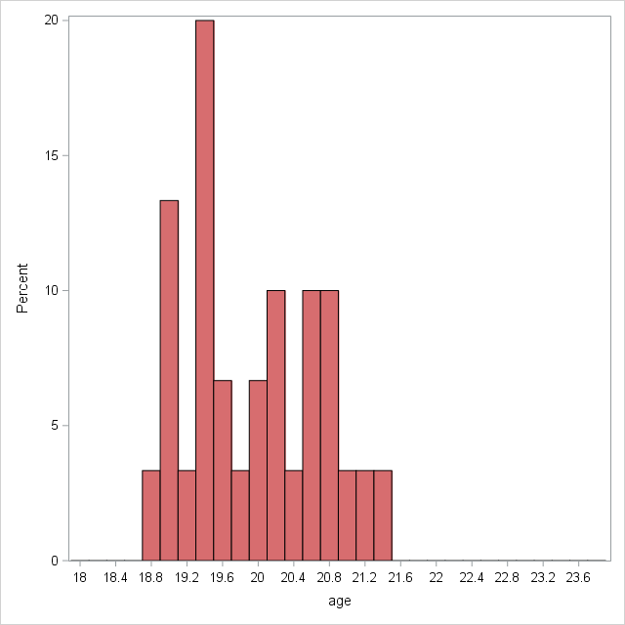
Density
Histogram
Consists of bins
Each rectangle is a bin

Slide 46
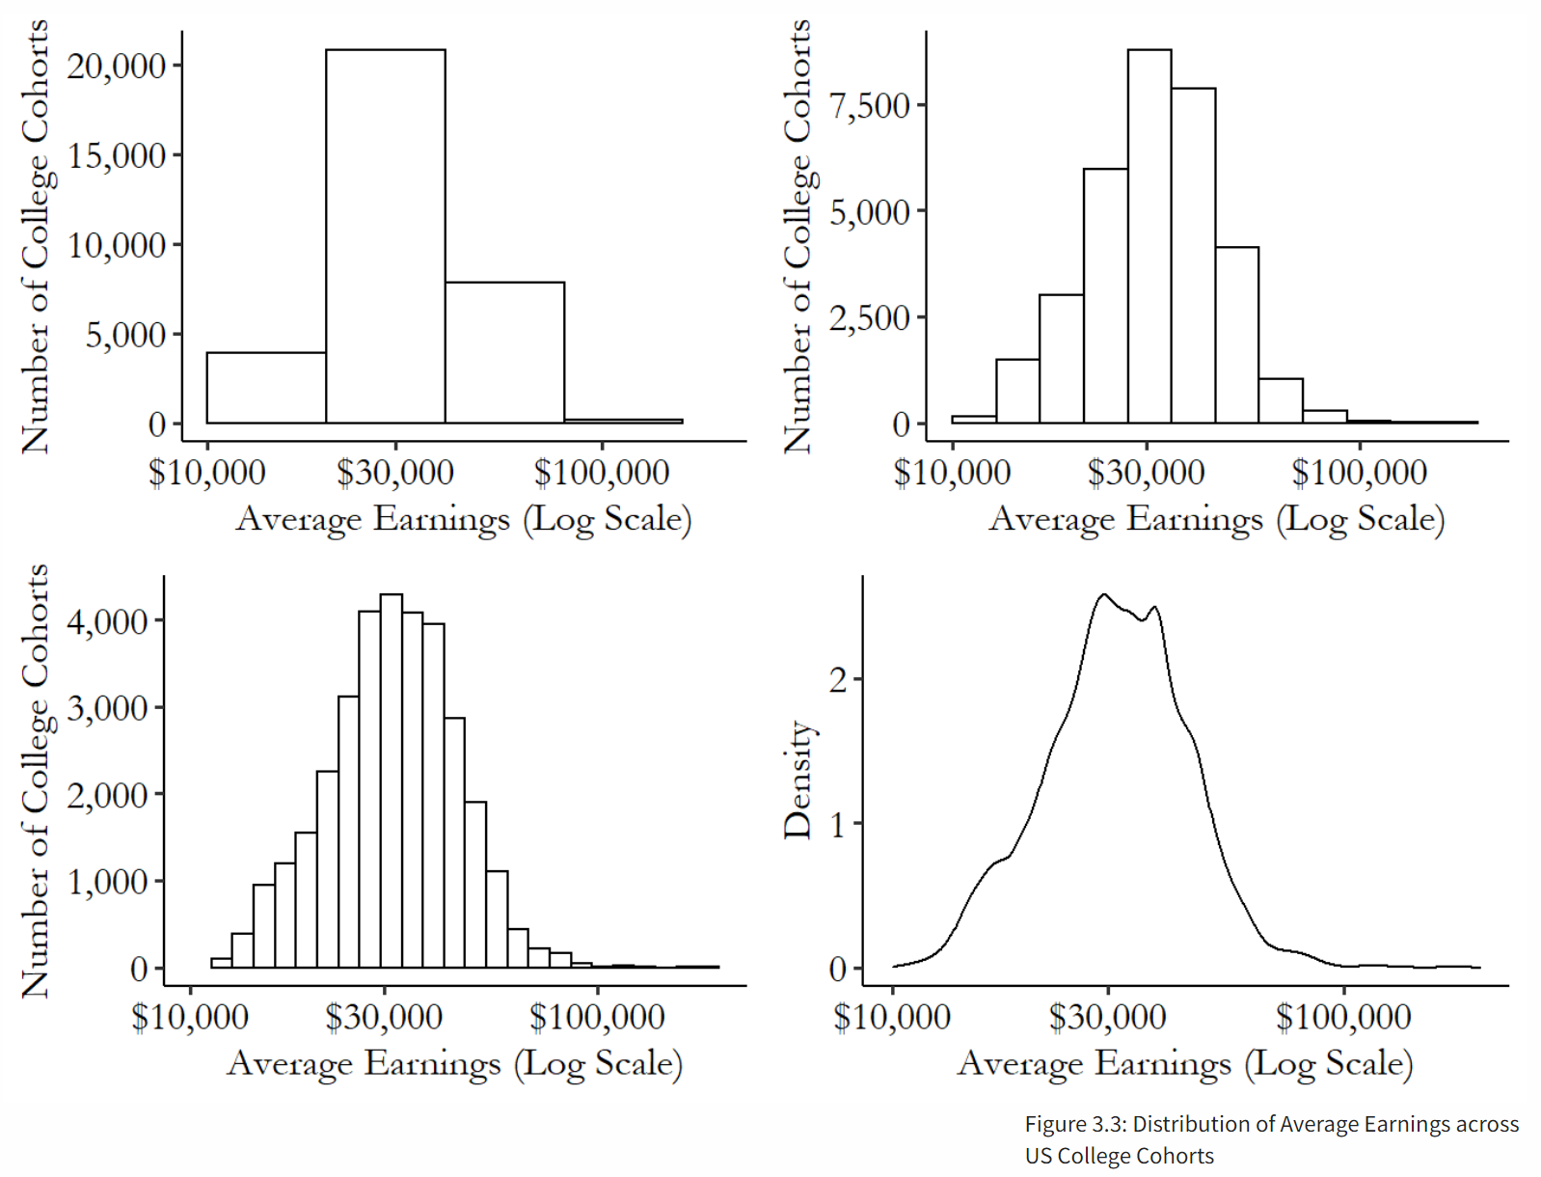
The effect: An Introduction to Research Design and Causality by Nick Huntington-Klein https://theeffectbook.net/

Slide 47
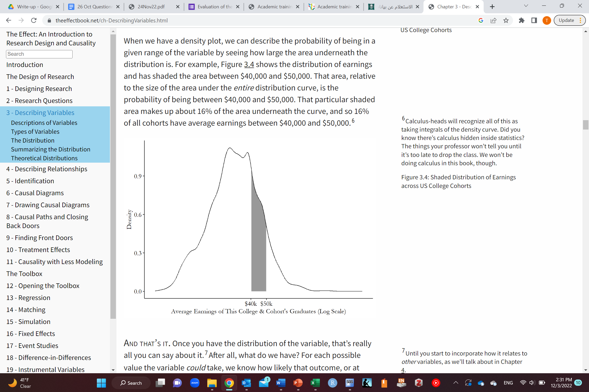
16% of the area under the curve
16% of data is between $40,000 and $50,000
All through calculus
The effect: An Introduction to Research Design and Causality by Nick Huntington-Klein https://theeffectbook.net/

Slide 48
Once we know the shape of the distribution (density)/histogram, how can we summarize the results?

Slide 49
Summarizing a distribution
We want to convey information about the distribution
Reductionist approach
Try to summarize the distribution by as few numbers as possible
A number that can give information about where the data is concentrated
Can you give me an example of such a number?

Slide 50
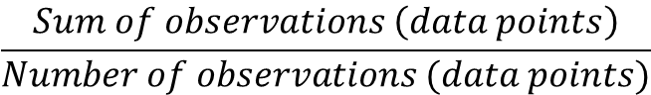
Summarizing a distribution
18.8 18.9 18.9 19.0 19.0
19.1 19.3 19.3 19.3 19.3
19.4 19.4 19.5 19.6 19.7
19.9 20.0 20.1 20.2 20.2
20.3 20.5 20.5 20.5 20.7
20.8 20.8 21.0 21.1 21.4
(18.8+18.9+18.9+19+19+19.1+19.3+19.3+19.3+19.3+19.4+19.4+19.5+19.6+19.7+19.9+20+20.1+20.2+20.2+20.3+20.5+20.5+20.5+20.7+20.8+20.8+21+21.1+21.4) / 30
19.9
Mean=
$$\frac{Sum of observations \left(data points\right)}{Number of observations (data points)}$$

Slide 51
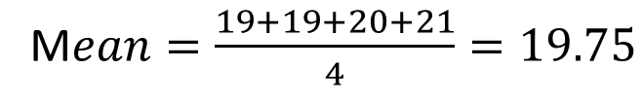
Summarizing a distribution
But what actually is the mean?
Another set of data of 4 people’s ages
19 19 20 21
M$ean=\frac{19+19+20+21}{4}=19.75$
Age | Frequency | Percentage | Weight | Age * weight
19 | 2 | 50% | 2/4=0.5 | 9.5
20 | 1 | 25% | 1/4=0.25 | 5
21 | 1 | 25% | 1/4=0.25 | 5.25
Total | 4 | 100% | 4/4=1 | 19.75
Scale each different/unique value by how likely you are to get it

Slide 52
Summarizing a distribution
Mean is a measure of central tendency
Produces a representative value
Mean age is 19.9
Is this information enough to accurately describe the distribution well?

Slide 53
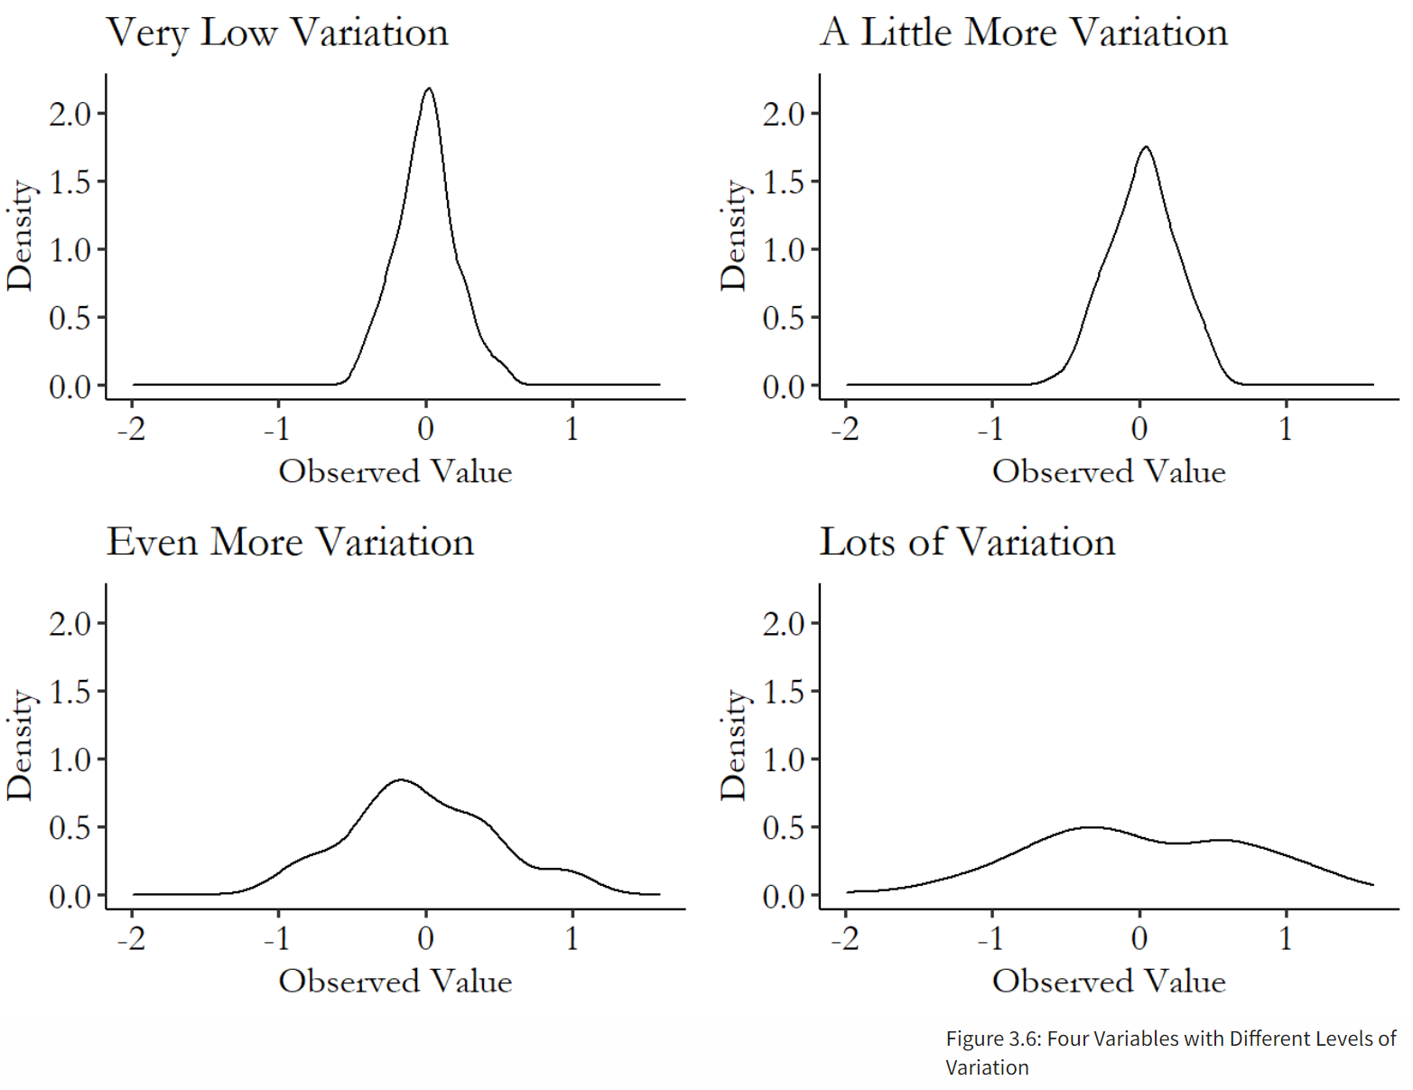
The effect: An Introduction to Research Design and Causality by Nick Huntington-Klein https://theeffectbook.net/

Slide 54
We need
A measure of variation also (measures of dispersion)
Variance (or standard deviation)
Median absolute deviation
Inter-quartile range
Etc

Slide 55
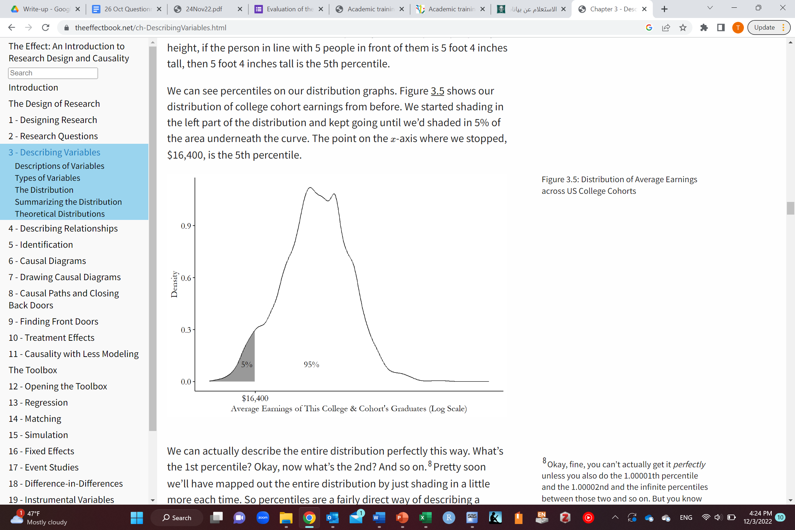
Summarizing a distribution
Instead of making a calculation (the mean) to describe the distribution, why not describe the distribution itself directly!
Percentile
$16,400 is the 5th percentile
The effect: An Introduction to Research Design and Causality by Nick Huntington-Klein https://theeffectbook.net/

Slide 56
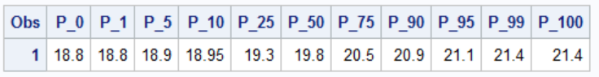
Summarizing a distribution
Let’s go back to our example
Median
The person right in the middle
Half the batch is younger than him/her and half is older

Slide 57
Summarizing a distribution
Median is another measure of central tendency
Produces a representative observation (data point)

Slide 58
Summarizing a distribution
Example: Checking the wealth of 10,000 people and one of them is Jeff Bezos
Mean
VS.
Median
“hmm… sure, most people don’t have much wealth, but once in a while you’re Jeff Bezos and that makes up for it. The mean is very high.”
“Jeff Bezos isn’t very representative of the rest of the people. He’s going to count exactly the same as everyone else. The median is relatively low.”
Represents a typical value
Represents a typical observation (data point/person in this case)
Affected by extremely high or low values (outliers)
Not effected by extremely high or low values (outliers)
The effect: An Introduction to Research Design and Causality by Nick Huntington-Klein https://theeffectbook.net/

Slide 59
Summarizing a distribution Mean VS. Median
Median is used
If you want to describe a typical observation
If you have highly skewed data with few extreme values (outliers)
Remember the example of Jeff Bezos and wealth (if you calculate mean, it would be very high but if you exclude Jeff Bezos, it would drop sharply)
Mean is sensitive to extreme values
Why use the mean then?
Has nice properties
Easier to work with mathematically (is in a lot of statistical calculations)
Sometimes you do want a representative value (not a representative observation)
Right skew
Left skew
The effect: An Introduction to Research Design and Causality by Nick Huntington-Klein https://theeffectbook.net/

Slide 60
Any Questions?
shihaybt@ksau-hs.edu.sa

